Slide 1
FIREWALLS
Firewalls in buildings, as their name implies, are walls intended to inhibit the spread of fire from one part of a building to another, for example, between one apartment and the next.
Firewalls are built of materials that withstand fires of a particular intensity or duration; they deter fire spread but are not guaranteed or intended to stop a particularly intense fire.
As computer security devices, network firewalls are similar, protecting one subnet from harm from another subnet.
The primary use of a firewall is to protect an internal subnetwork from the many threats.
Firewalls can also be used to separate segments of an internal network, for example, to preserve high confidentiality of a sensitive research network within a larger organization.

Slide 2
WHAT IS A FIREWALL?
Firewalls are one of the most important security devices for networks.
A firewall is a device that filters all traffic between a protected or “inside” network and a less trustworthy or “outside” network.
Usually a firewall runs on a dedicated device; because it is a single point through which traffic is channeled.
In practice, a firewall is a computer with memory, storage devices, interface cards for network access, and other devices. It runs an operating system and executes application programs.
Often the hardware, operating system, and applications are sold as a package, so the firewall application (a program) is sometimes also called a firewall.
A firewall is a computer traffic cop that permits or blocks data flow between two parts of a network architecture. It is the only link between parts.

Slide 3
WHAT IS A FIREWALL?
A firewall system typically does not have compilers, linkers, loaders, general text editors, debuggers, programming libraries, or other tools an attacker might use to extend an attack from the firewall computer. Because a firewall is executable code, an attacker could compromise that code and execute from the firewall’s device.
The purpose of a firewall is to keep “bad” things outside a protected environment. To accomplish that, firewalls implement a security policy that is specifically designed to address what bad things might happen.
For example, the policy might be to prevent any access from outside (while still allowing traffic to pass from the inside to the outside). Alternatively, the policy might permit accesses only from certain places, from certain users, or for certain activities.
Firewalls enforce predetermined rules governing what traffic can flow.

Slide 4
DESIGN OF FIREWALLS
Firewalls are simple devices that rigorously and effectively control the flow of data to and from a network.
Two qualities lead to that effectiveness:
a well-understood traffic flow policy and
a trustworthy design and implementation.

Slide 5
POLICY
A firewall implements a security policy, that is, a set of rules that determine what traffic can or cannot pass through the firewall.
As with many problems in computer security, we would ideally like a simple policy, such as “good” traffic can pass but “bad” traffic is blocked. Unfortunately, defining “good” and “bad” is neither simple nor algorithmic. Firewalls come with example policies, but each network administrator needs to determine what traffic to allow into a particular network.
An example of a simple firewall configuration is shown in Table. The table is processed from the top down, and the first matching rule determines the firewall’s action.
The * character matches any value in that field. This policy says any inbound traffic to port 25 (mail transfer) or port 69 (so-called trivial file transfer) is allowed to or from any host on the 192.168.1 subnetwork.
By rule 3 any inside host is allowed outbound traffic anywhere on port 80 (web page fetches). Furthermore, by rule 4 outside traffic to the internal host at destination address 192.168.1.18 (presumably a web server) is allowed.
All other traffic to the 192.168.1 network is denied.

Slide 6
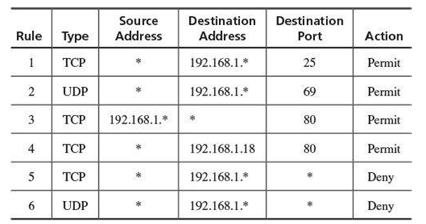
Example Firewall Configuration

Slide 7
Types of Firewalls
Packet filtering gateways or screening routers
Stateful inspection firewalls
Application-level gateways, also known as proxies
Circuit-level gateways
Guards
Personal firewalls

Slide 8
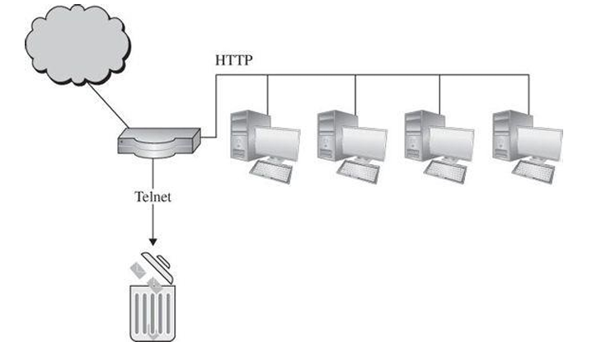
Packet filtering gateways
A packet filtering gateway or screening router is the simplest, and in some situations, the most effective type of firewall.
A packet filtering gateway controls access on the basis of packet address (source or destination) or specific transport protocol type (such as HTTP web traffic), that is, by examining the control information of each single packet.
A firewall can screen traffic before it gets to the protected network. So, if the port scan originated from address 100.200.3.4, you might configure the packet filtering gateway firewall to discard all packets from that address.
Figure shows a packet filter that blocks access from (or to) addresses in one network; the filter allows HTTP traffic but blocks traffic by using the Telnet protocol. Packet filters operate at OSI level 3.
Packet Filter

Slide 9
Packet filtering gateways
Packet filters—screening routers—limit traffic based on packet header data: addresses and ports on packets.
Packet filters do not “see inside” a packet; they block or accept packets solely on the basis of the IP addresses and ports. Thus, any details in the packet’s data field (for example, allowing certain Telnet commands while blocking other services) is beyond the capability of a packet filter.
Packet filters can perform the important service of ensuring the validity of inside addresses. An inside host typically trusts other inside hosts precisely because they are not outsiders: Outside is uncontrolled and fraught with harmful creatures.
But the only way an inside host can recognize another inside host is by the address shown in the source field of a message. Source addresses in packets can be forged, so an inside application might think it was communicating with another host on the inside instead of an outside forger.
A packet filter sits between the inside network and the outside net, so it can determine if a packet from the outside is forging an inside address, as shown in Figure.

Slide 10
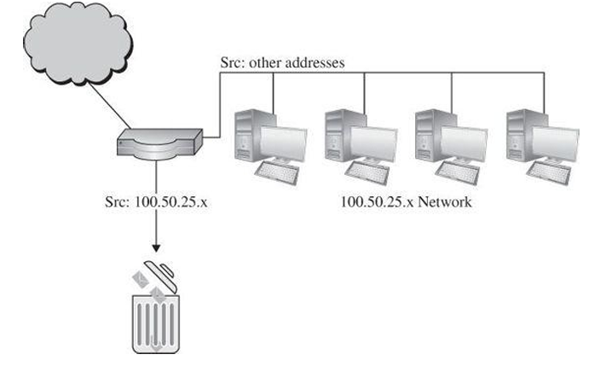
Packet filtering gateways
Packet Filter Screening Outside Hosts

Slide 11
Packet filtering gateways
When we say the filter “sits between” two networks we really mean it connects to both the inside and outside networks, by two separate interface cards. The packet filter can easily distinguish inside from outside traffic based on which interface a packet arrived on.
A screening packet filter might be configured to block all packets from the outside that claimed their source address was an inside address. In this example, the packet filter blocks all packets claiming to come from any address of the form 100.50.25.x (but, of course, it permits in any packets with destination 100.50.25.x).
A packet filter accepts or rejects solely according to the header information—address, size, protocol type—of each packet by itself. Such processing is simple, efficient, and fast, so a packet filtering firewall often serves as a sturdy doorkeeper to quickly eliminate obviously unwanted traffic.
The primary disadvantage of packet filtering routers is a combination of simplicity and complexity. The router’s inspection is simplistic; to perform sophisticated filtering, the rules set needs to be very detailed. A detailed rules set will be complex and therefore prone to error.
For example, blocking all port 23 traffic (Telnet) is simple and straightforward. But if some Telnet traffic is to be allowed, each IP address from which it is allowed must be specified in the rules.

Slide 12
Stateful Inspection Firewall
Filtering firewalls work on packets one at a time, accepting or rejecting each packet and moving on to the next. They have no concept of “state” or “context” from one packet to the next. A stateful inspection firewall maintains state information from one packet to another in the input stream.
Stateful inspection firewalls judge according to information from multiple packets.
Recall the description of observing probes against ports 1, 2, 3, 4, and so forth. By itself, a probe against port 1 is meaningless: It is most likely a legitimate attempt to connect to the service of port 1 or a single mistake, but it could also signal the start of a port scan attack.
The firewall records that address 100.200.3.4 sent a connection packet to port 1 at 01:37.26. When the probe against port 2 arrives, the firewall may record the second connection from 100.200.3.4, at 01:37.29. After two more connections at 01:37.34 and 01:37.36, the next connection at 01:37.39 meets the firewall’s rule for number of different ports in a short time, so it activates the rule to block connections from 100.200.3.4, as shown in Figure.
The firewall progresses through several states (the count of connection requests from address 100.200.3.4) from different packets until the count exceeds the threshold for acceptable behavior. The name stateful inspection refers to accumulating threat evidence across multiple packets.

Slide 13
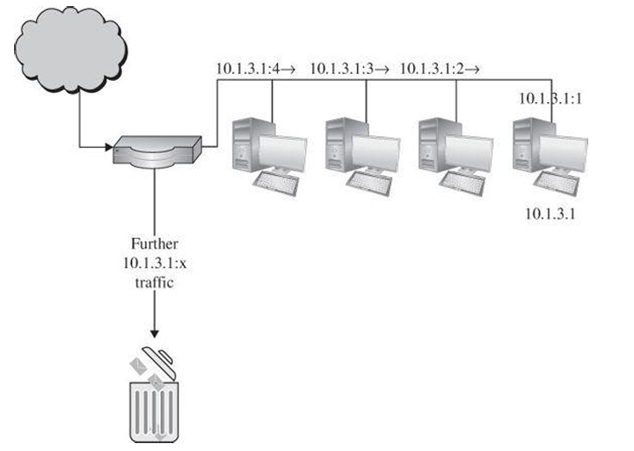
Stateful Inspection Firewall
One classic approach used by attackers is to break an attack into multiple packets by forcing some packets to have very short lengths so that a firewall cannot detect the characteristic of an attack split across two or more packets.
A stateful inspection firewall would track the sequence of packets and conditions from one packet to another to thwart such an attack.
Stateful Inspection Blocking Multiple Probes

Slide 14
Application Proxy
Packet filters look only at the headers of packets, not at the data inside the packets. Therefore, a packet filter would pass anything to port 25, assuming its screening rules allow inbound connections to that port.
But applications are complex and sometimes contain errors. Worse, applications (such as the email delivery agent) often act on behalf of all users, so they require privileges of all users (for example, to store incoming mail messages so that inside users can read them).
A flawed application, running with all-users privileges, can cause much damage.
An application proxy gateway, also called a bastion host, is a firewall that simulates the (proper) effects of an application at level 7 so that the application receives only requests to act properly.
A proxy gateway is a two-headed device: From inside, the gateway appears to be the outside (destination) connection, while to outsiders the proxy host responds just as the insider would. In fact, it behaves like a man in the middle.

Slide 15
Application Proxy
An application proxy simulates the behavior of a protected application on the inside network, allowing in only safe data.
An application proxy runs pseudoapplications. For instance, when electronic mail is transferred to a location, a sending process at one site and a receiving process at the destination communicate by a protocol that establishes the legitimacy of a mail transfer and then actually passes the mail message.
The protocol between sender and destination is carefully defined. A proxy gateway essentially intrudes in the middle of this protocol exchange, seeming like a destination in communication with the sender that is outside the firewall, and seeming like the sender in communication with the real recipient on the inside.
The proxy in the middle has the opportunity to screen the mail transfer, ensuring that only acceptable email protocol commands and content are sent in either direction.

Slide 16
To understand the real purpose of proxy gateway, let us consider several examples.
A company wants to set up an online price list so that outsiders can see the products and prices offered. It wants to be sure that (a) no outsider can change the prices or product list and (b) outsiders can access only the price list, not any of the more sensitive files stored inside.
A school wants to allow its students to retrieve any information from World Wide Web resources on the Internet. To help provide efficient service, the school wants to know what sites have been visited and what files from those sites have been fetched; particularly popular files will be cached locally.
A government agency wants to respond to queries through a database management system. However, the agency wants to screen results so that no names or identification are returned in results—only counts in categories.
A company with multiple offices wants to encrypt the data portion of all email to addresses at its other offices. (A corresponding proxy at the remote end will remove the encryption.)

Slide 17
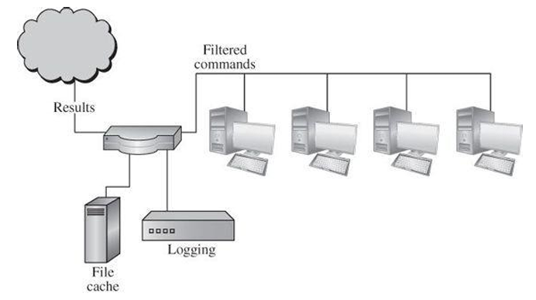
Proxy Firewall Functions
Each of these requirements can be met with a proxy.
In the first case, the proxy would monitor the file transfer protocol data to ensure that only the price list file was accessed and that the file could only be read, not modified.
The school’s requirement could be met by a logging procedure as part of the web browser.
The agency’s need could be satisfied by a special-purpose proxy that interacted with the database management system, performing queries but filtering the output.
A firewall application could encrypt and decrypt specific email messages for the last situation.
Proxy Firewall Functions

Slide 18
The proxies on the firewall can be tailored to specific requirements, such as logging details about accesses.
They can even present a common user interface to what may be dissimilar internal functions. Suppose the internal network has a mixture of operating system types, none of which support strong authentication through a challenge–response token.
The proxy can demand strong authentication (name, password, and challenge response), validate the challenge–response itself, and then pass on only simple name and password authentication details in the form required by a specific internal host’s operating system.
The distinction between a proxy and a screening router is that the proxy interprets the protocol stream as an application would, to control actions through the firewall on the basis of things visible within the protocol, not just on external header data.

Slide 19
Circuit-Level Gateway
A circuit-level gateway is a firewall that essentially allows one network to be an extension of another.
It operates at OSI level 5, the session level, and it functions as a virtual gateway between two networks.
A circuit is a logical connection that is maintained for a period of time, then torn down or disconnected.
The firewall verifies the circuit when it is first created. After the circuit has been verified, subsequent data transferred over the circuit are not checked.
Circuit-level gateways can limit which connections can be made through the gateway.

Slide 20
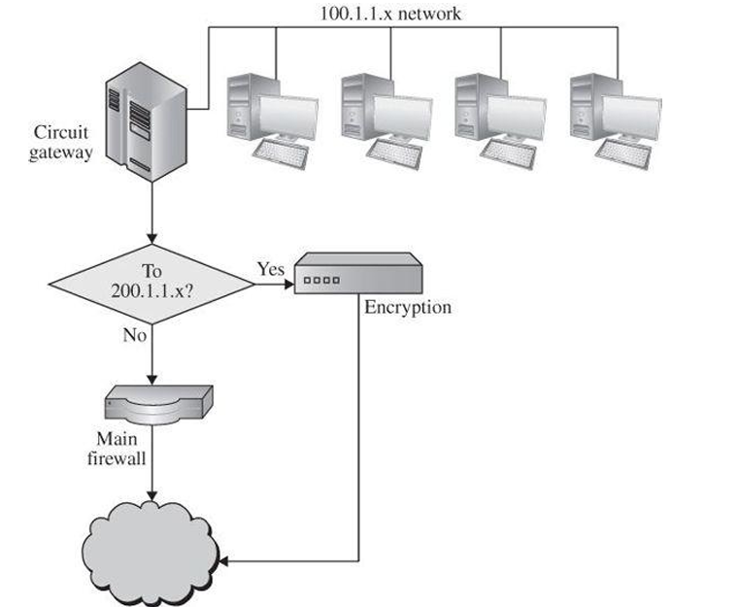
A circuit-level gateway connects two separate subnetworks as if they were one contiguous unit.
Circuit-Level Gateway

Slide 21
Circuit-Level Gateway
One use for a circuit-level gateway is to implement a virtual private network.
Suppose a company has two offices, each with its own network, at addresses 100.1.1.x and 200.1.1.x. Furthermore, the company wants to ensure that communication between these two address spaces is private, so the network administrator installs a pair of encryption devices.
The circuit-level gateway separates all traffic to and from the 100 and 200 networks, as shown . (This figure shows only the 100 network; a parallel structure exists on the 200 network.) The circuit gateway on the 100 network routes all traffic to the 200 network through an encryption device.
When traffic returns, the firewall on the 100 subnetwork routes all traffic from the 200 network through the encryption unit (for decryption) and back to the 100 gateway.
In this way, traffic flow between the 100 and 200 networks is automatically screened (so no other traffic can masquerade as part of this pair of protected networks), and encrypted for confidentiality.
Users are unaware of the cryptography and management is assured of the confidentiality protection.

Slide 22
Guard
A guard is a sophisticated firewall. Like a proxy firewall, it receives protocol data units, interprets them, and emits the same or different protocol data units that achieve either the same result or a modified result.
The guard determines what services to perform on the user’s behalf in accordance with its available information, such as whatever it can reliably ascertain of the (outside) user’s identity, previous interactions, and so forth.
The degree of control a guard can provide is limited only by what is computable. But guards and proxy firewalls are similar enough that the distinction between them is sometimes fuzzy.
That is, we can add functionality to a proxy firewall until it starts to look a lot like a guard.

Slide 23
Guard
Guard activities can be quite detailed, as illustrated in the following examples:
A university wants to allow its students to use email up to a limit of so many messages or so many characters of email in the last so many days. Although this result could be achieved by modifying email handlers, it is more easily done by monitoring the common point through which all email flows, the mail transfer protocol.
A school wants its students to be able to access the World Wide Web but, because of the capacity of its connection to the web, it will allow only so many bytes per second (that is, allowing text mode and simple graphics but disallowing complex graphics, video, music, or the like).
A library wants to make available certain documents but, to support fair use of copyrighted matter, it will allow a user to retrieve only the first so many characters of a document. After that amount, the library will require the user to pay a fee that will be forwarded to the author.
A company is developing a new product based on petroleum and helium gas, code-named “light oil.” In any outbound data flows, as file transfers, email, web pages, or other data stream, it will replace the words “petroleum,” “helium,” or “light oil” with “magic.” A firewall is thought of primarily as an inbound filter: letting in only appropriate traffic (that which conforms to the firewall’s security policy). This example shows that a firewall or guard can just as easily screen outbound traffic.

Slide 24
Guard
A company wants to allow its employees to fetch files by FTP. However, to prevent introduction of viruses, it will first pass all incoming files through a virus scanner. Even though many of these files will be nonexecutable text or graphics, the company administrator thinks that the expense of scanning them (which file shall pass) will be negligible.
A guard can implement any programmable set of conditions, even if the program conditions become highly sophisticated.
Each of these scenarios can be implemented as a modified proxy. Because the proxy decision is based on some quality of the communication data, we call the proxy a guard.
Since the security policy implemented by the guard is somewhat more complex than the action of a proxy, the guard’s code is also more complex and therefore more exposed to error.

Slide 25
Personal Firewalls
Firewalls typically protect a (sub)network of multiple hosts.
University students and employees in offices are behind a real firewall.
Increasingly, home users, individual workers, and small businesses use cable modems or DSL connections with unlimited, always-on access. These people need a firewall, but a separate firewall computer to protect a single workstation can seem too complex and expensive. These people need a firewall’s capabilities at a lower price.
A personal firewall is an application program that runs on the workstation it protects.
A personal firewall can complement the work of a conventional firewall by screening the kind of data a single host will accept, or it can compensate for the lack of a regular firewall, as in a private DSL or cable modem connection.

Slide 26
Personal Firewalls
A personal firewall is a program that runs on a single host to monitor and control traffic to that host. It can only work in conjunction with support from the operating system.
Just as a network firewall screens incoming and outgoing traffic for that network, a personal firewall screens traffic on a single workstation.
A workstation could be vulnerable to malicious code or malicious active agents (ActiveX controls or Java applets), leakage of personal data stored on the workstation, and vulnerability scans to identify potential weaknesses.
Commercial implementations of personal firewalls include SaaS Endpoint Protection from McAfee, F-Secure Internet Security, Microsoft Windows Firewall, and Zone Alarm from CheckPoint.

Slide 27
Personal Firewalls
The personal firewall is configured to enforce some policy.
For example, the user may decide that certain sites, such as computers on the company network, are highly trustworthy, but most other sites are not. Vendors sometimes supply and maintain lists of unsafe sites to which their products block access by default.
The user defines a policy permitting download of code, unrestricted data sharing, and management access from the corporate segment but not from other sites.
Personal firewalls can also generate logs of accesses, which can be useful to examine in case something harmful does slip through the firewall.
Combining a malware scanner with a personal firewall is both effective and efficient. Typically, users forget to run scanners regularly, but they do remember to run them occasionally, such as sometime during the week.

Slide 28
Personal Firewalls
However, leaving the scanner execution to the user’s memory means that the scanner detects a problem only after the fact—such as when a virus has been downloaded in an email attachment.
With the combination of a virus scanner and a personal firewall, the firewall directs all incoming email to the virus scanner, which examines every attachment the moment it reaches the target host and before it is opened.
A personal firewall runs on the very computer it is trying to protect. Thus, a clever attacker is likely to attempt an undetected attack that would disable or reconfigure the firewall for the future.

Slide 29
Comparison of Firewall Types
Firewall types are arranged generally from least sophisticated on the left to more so on the right, with the exception of personal firewalls, which are more like an enterprise packet filter.
Do not, however, interpret least sophisticated as meaning weakest or least desirable; in fact, packet filtering firewalls are the work horses of enterprise networks, quickly and efficiently blocking much undesirable traffic.

Slide 30
Packet Filter | Stateful Inspection | Application Proxy | Circuit Gateway | Guard | Personal Firewall
Simplest decision-making rules, packet by packet | Correlates data across packets | Simulates effect of an application program | Joins two subnetworks | Implements any conditions that can be programmed | Similar to packet filter, but getting more complex
Sees only addresses and service protocol type | Can see addresses and data | Sees and analyses full data portion of packet | Sees addresses and data | Sees and analyzes full content of data | Can see full data portion
Auditing limited because of speed limitations | Auditing possible | Auditing likely | Auditing likely | Auditing likely | Auditing likely
Screens based on connection rules | Screens based on information across multiple packets – in either headers or data | Screens based on behavior of application | Screens based on address | Screens based on interpretation of content | Typically, screens based on content of each packet individually, based on address or content
Complex addressing rules can make configuration tricky | Usually preconfigured to detect certain attack signatures | Simple proxies can substitute for complex decision rules, but proxies must be aware of application’s behavior | Relatively simple addressing rules, make configuration straightforward | Complex guard functionality; can be difficult to define and program accurately | Usually starts in mode to deny all inbound traffic; adds addresses and functions to trust as they arise

Slide 31
Configuring a Simple Firewall
Basic traffic filtering is limited to configured access list implementations that examine packets at the network layer or, at most, the transport layer, permitting or denying the passage of each packet through the firewall.
However, the use of inspection rules in CBAC allows the creation and use of dynamic temporary access lists.

Slide 32
Configuring a Simple Firewall
These dynamic lists allow temporary openings in the configured access lists at firewall interfaces.
These openings are created when traffic for a specified user session exits the internal network through the firewall.
The openings allow returning traffic for the specified session (that would normally be blocked) back through the firewall.

Slide 33
Configuring a Simple Firewall
The following Figure shows a network deployment using PPPoE or PPPoA with NAT and a firewall.

Slide 34
Configuring a Simple Firewall
Multiple networked devices—Desktops, laptop PCs, switches
Fast Ethernet LAN interface (the inside interface for NAT)
PPPoE or PPPoA client and firewall implementation—Cisco 1811/1812 or Cisco 1801/1802/1803 series integrated services router, respectively
Point at which NAT occurs
Protected network
Unprotected network
Fast Ethernet or ATM WAN interface (the outside interface for NAT)

Slide 35
Configuration Tasks
Configure Access Lists
Configure Inspection Rules
Apply Access Lists and Inspection Rules to Interfaces

Slide 36
Configure Access Lists
Perform these steps to create access lists for use by the firewall, beginning in global configuration mode:
Step 1
Command
access-list access-list-number {deny | permit} protocol
source source-wildcard [ operator [port]] destination
Example
Router(config)# access-list 103 permit host 200.1.1.1 eq
isakmp any
Router(config)#
Purpose
Creates an access list which prevents Internet- initiated traffic from reaching the local (inside) network of the router, and which compares source and destination ports.

Slide 37
Configure Access Lists
Step 2
Command
access-list access-list-number {deny | permit} protocol
source source-wildcard destination destination-wildcard
Example
Router(config)# access-list 105 permit ip 10.1.1.0 0.
0.0.255 192.168.0.0 0.0.255.255
Router(config)#
Purpose
Creates an access list that allows network traffic to pass freely between the corporate network and the local networks through the configured VPN tunnel.

Slide 38
Configure Inspection Rules
Perform these steps to configure firewall inspection rules for all TCP and UDP traffic, as well as specific application protocols as defined by the security policy, beginning in global configuration mode:
Step 1
Command
ip inspect name inspection-name protocol
Example
Router(config)# ip inspect
name firewall tcp
Router(config)#
Purpose
Defines an inspection rule for a particular protocol.

Slide 39
Apply Access Lists and Inspection Rules to Interfaces
Perform these steps to apply the ACLs and inspection rules to the network interfaces, beginning in global configuration mode:
Step 1
Command
interface type number
Example
Router(config)# interface vlan 1
Router(config-if)#
Purpose
Enters interface configuration mode for the inside network interface on your router.

Slide 40
Apply Access Lists and Inspection Rules to Interfaces
Step 2
Command
ip inspect inspection-name { in | out }
Example
Router(config-if)# ip inspect firewall in
Router(config-if)#
Purpose
Assigns the set of firewall inspection rules to the inside interface on the router.

Slide 41
Apply Access Lists and Inspection Rules to Interfaces
Step 3
Command
Exit
Example
Router(config-if)# exit
Router(config)#
Purpose
Returns to global configuration mode.

Slide 42
Apply Access Lists and Inspection Rules to Interfaces
Step 4
Command
interface type number
Example
Router(config)# interface fastethernet 0
Router(config-if)#
Purpose
Enters interface configuration mode for the outside network interface on your router.

Slide 43
Apply Access Lists and Inspection Rules to Interfaces
Step 5
Command
ip access-group { access-list-number
| access-list-name } { in | out }
Example
Router(config-if)# ip access-group 103
in
Router(config-if)#
Purpose
Assigns the defined ACLs to the outside interface on the router..

Slide 44
Apply Access Lists and Inspection Rules to Interfaces
Step 6
Command
exit
Example
Router(config-if)# exit
Router(config)#
Purpose
Returns to global configuration mode.

Slide 45
Configure Inspection Rules
Step 2
Command
ip inspect name inspection-name protocol
Example
Router(config)# ip inspect
name firewall rtsp
Router(config)# ip inspect
name firewall h323
Router(config)# ip inspect
name firewall netshow
Router(config)# ip inspect
name firewall ftp
Router(config)# ip inspect
name firewall sqlnet
Router(config)#
Purpose
Repeat this command for each inspection rule that you wish to use.

Slide 46
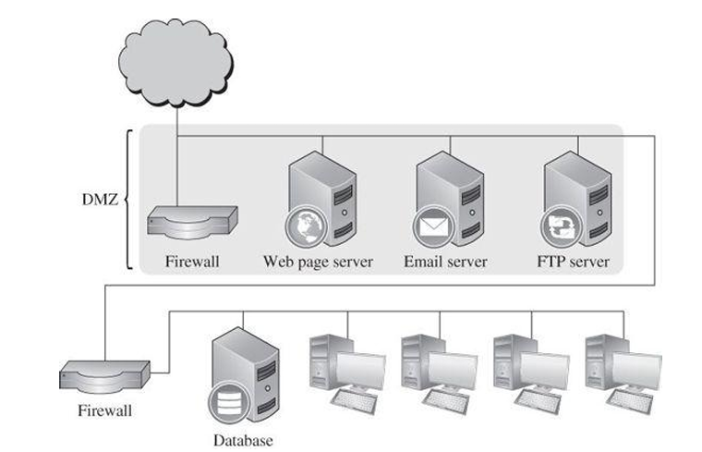
The same architecture can be extended, as shown in Figure. In this figure, the externally accessible services, such as web pages, email, and file transfer, are on servers in the demilitarized zone or DMZ, named after the military buffer space, sometimes called the “no man’s land,” between the territories held by two competing armies.
In all these examples, the network architecture is critical. A firewall can protect only what it can control, so if a subnetwork has external connections not screened by the firewall, the firewall cannot control traffic on that unscreened connection.
An example is a device with its own direct Internet connection (perhaps a rogue wireless connection). The wireless connection mentioned here, can give an attacker visibility and access to other devices.
For this reason, the only path to every protected network device must pass through the network’s firewall. Although these examples are simplifications, they show the kinds of configurations firewalls protect.
Outside users can access tools and data in a firewall’s demilitarized zone but cannot get to more sensitive resources on the more protected inside network.
Demilitarized Zone

Slide 47
What Firewalls Can and Cannot Block?
Firewalls are not complete solutions to all computer security problems. A firewall protects only the perimeter of its environment against attacks from outsiders who want to execute code or access data on the machines in the protected environment.
Firewalls can protect an environment only if the firewalls control the entire perimeter. That is, firewalls are effective only if no unmediated connections breach the perimeter. If even one inside host connects to an outside address, by a wireless connection for example, the entire inside net is vulnerable through the unprotected host.
Firewalls do not protect data outside the perimeter; data that have properly passed (outbound) through the firewall are just as exposed as if there were no firewall.
Firewalls are the most visible part of an installation to the outside, so they are the most attractive target for attack. For this reason, several different layers of protection, called defense in depth, are better than relying on the strength of just a single firewall.

Slide 48
What Firewalls Can and Cannot Block?
Firewalls must be correctly configured, that configuration must be updated as the internal and external environment changes, and firewall activity reports must be reviewed periodically for evidence of attempted or successful intrusion.
Firewalls are targets for penetrators. While a firewall is designed to withstand attack, it is not impenetrable. Designers intentionally keep a firewall small and simple so that even if a penetrator breaks it, the firewall does not have further tools, such as compilers, linkers, loaders, and the like, to continue an attack.
Firewalls exercise only minor control over the content admitted to the inside, meaning that inaccurate data or malicious code must be controlled by other means inside the perimeter.
Firewalls are important tools in protecting an environment connected to a network. However, the environment must be viewed as a whole, all possible exposures must be considered, and the firewall must fit into a larger, comprehensive security strategy. Firewalls alone cannot secure an environment.

Slide 49
Network Address Translation (NAT)
Firewalls protect internal hosts against unacceptable inbound or outbound data flows.
However, sometimes an outsider can gain valuable information just by learning the architecture, connectivity, or even size of the internal network.
When an internal host presents its IP address to an outsider (necessary if the outsider is expected to reply), the outsider can infer some of the network structure from the pattern of addresses.
Furthermore, once released, this address will forever be known and exploitable by outsiders.

Slide 50
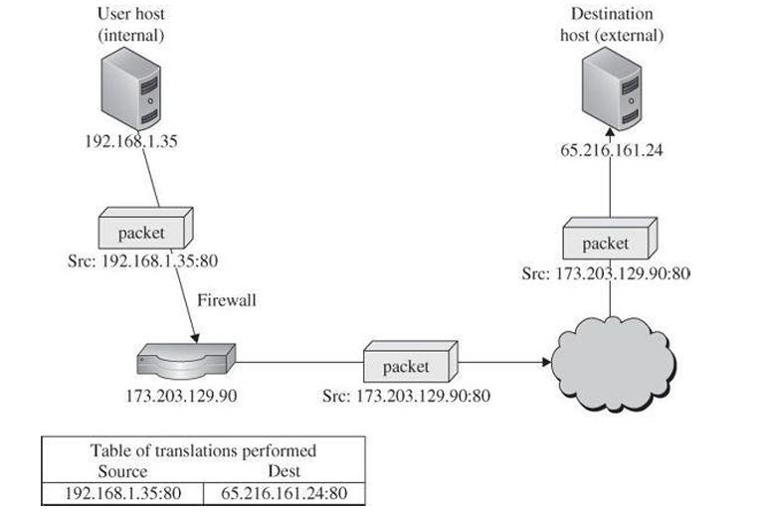
Network Address Translation (NAT)
Every packet between two hosts contains the source host’s address and port and the destination host’s address and port. Port 80 is the number conventionally used for HTTP (web page) access.
As shown in Figure, internal host 192.168.1.35 port 80 is sending a packet to external host 65.216.161.24 port 80. Using a process called network address translation (NAT), the source firewall converts source address 192.168.1.35:80 in the packet to the firewall’s own address, 173.203.129.90.
The firewall also makes an entry in a translation table showing the destination address, the source port, and the original source address, to be able to forward any replies to the original source address.
As we might expect, the firewall converts the address back on any return packets.
Network Address Translation

Slide 51
Network Address Translation (NAT)
Network address translation conceals real internal addresses; outsiders who do not know real addresses cannot access them directly.
The only complication to this scheme occurs if two internal hosts both contact the same destination address over the same port, which might be expected if two internal hosts independently wanted to access the web page at www.google.com, for example.
In this case, the firewall would rewrite the source port number of one requesting host to a random different number so that the firewall could properly retranslate the return. Internal host 192.168.1.35 might become 173.203.129.90 port 4236, and 192.168.1.57 might become 173.203.129.90 port 4966.
The outside world sees only one external address, 173.203.129.90 for the whole secured internal network, so outsiders cannot infer the structure of the internal network.
Finally, knowing the supposed address of an insider will not help an outsider later: If an outsider crafts traffic to the same address at a later time, the firewall will reject the traffic because the sender’s address is no longer in the translation table. Although primarily used because of another problem (limited public address numbers), network address translation performs a significant security role.

Slide 52
Data Loss Prevention (DLP)
Data loss prevention (DLP) refers to a set of technologies designed to detect and possibly prevent attempts to send data where it is not allowed to go.
Typical data of concern are classified documents, proprietary information, and private personal information (e.g., social security numbers, credit card numbers).
DLP can be implemented in a number of ways: Agent-based systems might be installed as OS rootkits that monitor user behavior, including network connections, file accesses, and applications run.
Network-based solutions monitor network connections, especially file transfers. Other solutions may be application-specific, such as software agents for monitoring email.

Slide 53
Data Loss Prevention (DLP)
DLP solutions will generally look for a variety of indicators:
Keywords. Certain words or phrases, such as “secret,” “classified,” or “proprietary,” are strong indicators of sensitive data. DLP solutions may also allow customers to search for keywords that have specific meaning for a particular business, such as a codename for a new product.
Traffic patterns. Some traffic patterns that may indicate suspicious behavior are bulk file transfers, connections to outside email or file sharing services, emails to unknown recipients, and connections to unknown network services.
Encoding/encryption. DLP can be easily defeated by strong encryption, because no DLP solution can determine the sensitivity of a file it cannot read. To address this issue, DLP solutions commonly block outgoing files that they cannot decode or decrypt. Many malware scanners treat incoming files, such as encrypted email attachments, the same way.

Slide 54
Data Loss Prevention (DLP)
While DLP solutions are useful for preventing accidental data leakage, they are more fragile than other security solutions.
A determined attacker can frequently find a way to transfer data into a system, although an effective DLP solution may slow the process down or alert security personnel in time to prevent it.
Firewalls are sometimes called edge devices, meaning that they are positioned at the boundary of a subnetwork.
DLP approaches can be integrated into a firewall, installed in an operating system, or joined to another application program that manipulates sensitive date.
Thus, DLP technologies are not restricted to the edge of a protected subnetwork.
Next we focus on intrusion detection and protection systems, monitoring products that are also placed inside a subnetwork.

Slide 55
Intrusion Detection and Prevention Systems
After the perimeter controls, firewall, and authentication and access controls block certain actions, some users are admitted to use a computing system. Most of these controls are preventive: They block known bad things from happening.
Many studies have shown that most computer security incidents are caused by insiders or people impersonating them, people who would not be blocked by a firewall. And insiders require access with significant privileges to do their daily jobs.
The vast majority of harm from insiders is not malicious; it is honest people making honest mistakes. Then, too, there are the potential malicious outsiders who have somehow passed the screens of firewalls and access controls.
Prevention, although necessary, is not a complete computer security control.
Intrusion detection systems complement these preventive controls as the next line of defense.
An intrusion detection system (IDS) is a device, typically another separate computer, that monitors activity to identify malicious or suspicious events.
An IDS is a sensor, like a smoke detector, that raises an alarm if specific things occur.

Slide 56
Intrusion Detection and Prevention Systems
As with smoke alarms, detecting danger necessitates action.
Whether the response is calling the fire department, activating a sprinkler system, sounding an evacuation alarm, or alerting the control team (or all of these) depends on what advance plans have been made to handle the incident.
IDSs likewise have a response function. In many cases the response is to alert a human team that will then decide what further action is warranted.
Sometimes, however, the IDS goes into protection mode to isolate a suspected intruder and constrain access. Such a system is called an Intrusion Protection System (IPS).

Slide 57
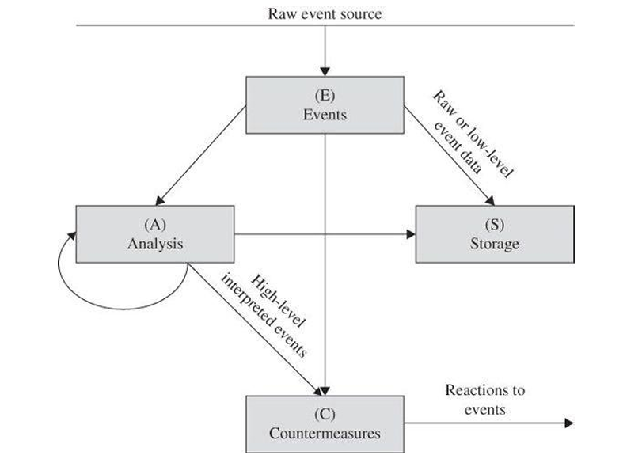
The components in the figure are the four basic elements of an intrusion detection system, based on the Common Intrusion Detection Framework.
An IDS receives raw inputs from sensors. It saves those inputs, analyzes them, and takes some controlling action.
Model of an Intrusion Detection System

Slide 58
Intrusion Detection and Prevention Systems
IDSs perform a variety of functions:
monitoring users and system activity
auditing system configuration for vulnerabilities and misconfigurations
assessing the integrity of critical system and data files
recognizing known attack patterns in system activity
identifying abnormal activity through statistical analysis
managing audit trails and highlighting user violation of policy or normal activity
correcting system configuration errors
installing and operating traps to record information about intruders
No one IDS performs all of these functions.

Slide 59
Types of IDSs
The two general types of intrusion detection systems are signature based and heuristic.
Signature-based intrusion detection systems perform simple pattern-matching and report situations that match a pattern (signature) corresponding to a known attack type.
Heuristic intrusion detection systems, also known as anomaly based, build a model of acceptable behavior and flag exceptions to that model; for the future, the administrator can mark a flagged behavior as acceptable so that the heuristic IDS will now treat that previously unclassified behavior as acceptable. Thus, heuristic intrusion detection systems are said to learn what constitute anomalies or improper behavior.
This learning occurs as an artificial intelligence component of the tool, the inference engine, identifies pieces of attacks and rates the degree to which these pieces are associated with malicious behavior.

Slide 60
Types of IDSs
Signature-based IDSs look for patterns; heuristic ones learn characteristics of unacceptable behavior over time.
Intrusion detection devices can be network based or host based.
A network-based IDS is a stand-alone device attached to the network to monitor traffic throughout that network.
A host-based IDS runs on a single workstation or client or host, to protect that one host.

Slide 61
Signature Based Intrusion Detection
A simple signature for a known attack type might describe a series of TCP SYN packets sent to many different ports in succession and at times close to one another, as would be the case for a port scan.
An intrusion detection system would probably find nothing unusual in the first SYN, say, to port 80, and then another (from the same source address) to port 25. But as more and more ports receive SYN packets, especially ports that normally receive little traffic, this pattern reflects a possible port scan.
The problem with signature-based detection is the signatures themselves. An attacker will try to modify a basic attack in such a way that it will not match the known signature of that attack. For example, the attacker may convert lowercase to uppercase letters or convert a symbol such as “blank space” to its character code equivalent %20.
The IDS must necessarily work from a canonical form of the data stream to recognize that %20 matches a pattern with a blank space. The attacker may insert spurious packets that the IDS will see, or shuffle the order of reconnaissance probes, to intentionally cause a pattern mismatch.
Each of these variations could be detected by an IDS, but more signatures require additional work for the IDS, thereby reducing performance.

Slide 62
Signature Based Intrusion Detection (State based)
Of course, a signature-based IDS cannot detect a new attack for which no signature has yet been installed in the database.
Every attack type starts as a new pattern at some time, and the IDS is helpless to warn of its existence. Attackers also try to change their signature.
Signature-based intrusion detection systems tend to use statistical analysis. This approach uses tools both to obtain sample measurements of key indicators (such as amount of external activity, number of active processes, number of transactions) and to determine whether the collected measurements fit the predetermined attack signatures.
Signature-based IDSs are limited to known patterns.

Slide 63
Heuristic Intrusion Detection (Model based)
Instead of looking for matches, heuristic intrusion detection looks for behavior that is out of the ordinary.
For example, one user might always start the day by reading email, write many documents using a word processor, and occasionally back up files. These actions would be normal. This user does not seem to use many administrator utilities.
If that person tried to access sensitive system management utilities, this new behavior might be a clue that someone else was acting under the user’s identity.

Slide 64
Heuristic Intrusion Detection
If we think of a compromised system in use, it started clean, with no intrusion, and it ended dirty, fully compromised. There may be no point in an administrator’s tracing the use in which the system changed from clean to dirty; it was more likely that little dirty events occurred, occasionally at first and then increasing as the system became more deeply compromised.
Any one of those events might be acceptable by itself, but the accumulation of them and the order and speed at which they occurred could have been signals that something unacceptable was happening.
The inference engine of an intrusion detection system continuously analyzes the system, raising an alert when the system’s dirtiness exceeds a threshold or when a combination of factors signals likely malicious behavior.

Slide 65
Heuristic Intrusion Detection
Let’s consider an example. A network computer belonging to Ana starts to inspect other network computers, looking at which ones have storage areas (files) available to other network users.
When Ana probes Boris’s computer the IDS may classify that act as unusual, but Boris’s computer denies her access and the IDS simply notes the denied access request. Then when Ana probes Chen’s machine the second attempt becomes more unusual.
It turns out that Chen’s machine has a file structure open to the network, and Ana obtains a directory listing of all accessible files on Chen’s machine, which the IDS flags as suspicious.
When Ana then tries to copy all of Chen’s files the IDS recognizes a likely attack and triggers an alarm to an administrator. Any of the actions Ana (or someone using Ana’s access credentials) took is not significant by itself, but the accumulation leads to greater suspicion and finally an alarm.

Slide 66
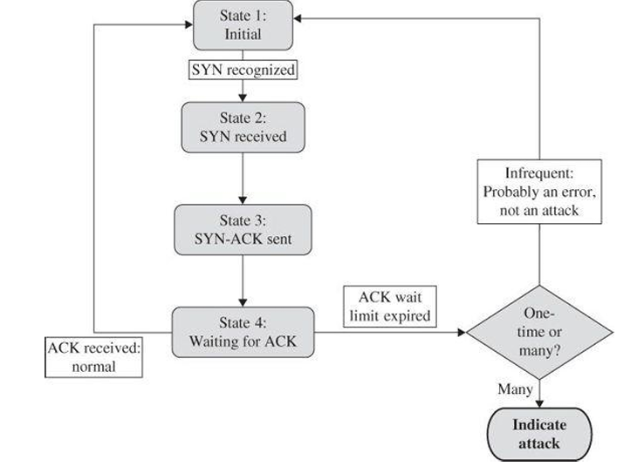
Stateful Protocol Analysis
Intrusion detection by means of pattern matching is difficult if the pattern to be matched is long or variable.
A SYN flood attack has a simple pattern (SYN, SYN ACK, no corresponding ACK), but these are three separate steps spread over time; detecting the attack requires recognizing step one, later finding step two, and then waiting a reasonable amount of time before concluding that step three is true.
Think of an intrusion detection system as a state machine, with a state for each of these steps, as shown in Figure. The IDS needs to record which state it is in. Now multiply the number of states to account for hundreds of thousands of concurrent connections by many users. The logic of the IDS is complicated: Many handshakes may be in progress at any time, and the IDS must maintain the state of each of them.
IDS State Machine

Slide 67
Stateful Protocol Analysis
Other protocols have similar stateful representations. As the IDS monitors traffic, it will build a similar state representation, matching traffic to the expected nature of the interchange.
The different protocols with their different states and transition conditions is multiplied by the number of instances (for example, the number of concurrent TCP connections being established at any time), making the IDS bookkeeping complex indeed.
IDS State Machine

Slide 68
Front End Versus Internal IDSs
An IDS can be placed either at the front end of a monitored subnetwork or on the inside.
A front-end device monitors traffic as it enters the network and thus can inspect all packets; it can take as much time as needed to analyze them, and if it finds something that it classifies as harmful, it can block the packet before the packet enters the network.
A front-end intrusion detection system may be visible on the outside, and thus it may be a target of attack itself.
Skillful attackers know that disabling the defenses of an IDS renders the network easier to attack.

Slide 69
Front End Versus Internal IDSs
On the other hand, a front-end IDS does not see inside the network, so it cannot identify any attack originating inside.
An internal device monitors activity within the network. If an attacker is sending unremarkable packets to a compromised internal machine, instructing that machine to initiate a denial-of-service attack against other hosts on that network, a front-end IDS will not notice that attack. Thus, if one computer begins sending threatening packets to another internal computer, the internal IDS would be able to detect that.
An internal IDS is also more well protected from outside attack. Furthermore, an internal IDS can learn typical behavior of internal machines and users so that if, for example, user A suddenly started trying to access protected resources after never having done so previously, the IDS could record and analyze that anomaly.

Slide 70
Host Based and Network based IDS
Host-based intrusion detection (called HIDS) protects a single host against attack. It collects and analyzes data for that one host.
The operating system supplies some of that data to the IDS, passing along approved and denied requests to access sensitive resources, logs of applications run, times and dates of actions and other security-relevant data.
The device either analyzes data itself or forwards the data to a separate machine for analysis and perhaps correlation with HIDSs on other hosts.
The goal of a host-based system is to protect one machine and its data. If an intruder disables that IDS, however, it can no longer protect its host. Being a process on the target computer also exposes the HIDS to the vulnerability of being detected.
A network-based IDS or NIDS is generally a separate network appliance that monitors traffic on an entire network.
It receives data from firewalls, operating systems of the connected computers, other sensors such as traffic volume monitors and load balancers, and administrator actions on the network.

Slide 71
Host Based and Network based IDS
The goal of a NIDS is to protect the entire network or some set of specific sensitive resources, such as a collection of servers holding critical data. The detection software can also monitor the content of packets communicated across the network, to detect, for example, unusual actions by one host (that might have been compromised) against another.
A network IDS is better able to protect itself against detection or compromise than a host-based one because the network IDS can operate in so-called stealth mode, observing but never sending data onto the network.
Its network interface card can even be restricted to receive data only, never doing anything to reveal its connection to the network.
A HIDS monitors host traffic; a NIDS analyzes activity across a whole network to detect attacks on any network host. Another advantage of an NIDS is that it can send alarms on a separate network from the one being monitored. That way an attacker will not know the attack has been recognized.

Slide 72
Other Intrusion Detection Technology
Now, intrusion detection capabilities are sometimes embedded in other devices (such as routers and firewalls).
Thus, companies now claim that many tools or products are intrusion detection devices, and new terms have been introduced with which vendors seek to gain a competitive edge by highlighting fine distinctions.
Code Modification Checkers
Some security engineers consider other devices to be IDSs as well. For instance, to detect unacceptable code modification, programs can compare the active version of software code with a saved version of a digest of that code.
The Tripwire program is a typical static data comparison program. It can detect changes to executable programs and other data files that should never or seldom change.
Vulnerability Scanners
System vulnerability scanners, such as ISS Scanner or Nessus, can be run against a network. They check for known vulnerabilities and report flaws found.

Slide 73
Intrusion Prevention Systems
Intrusion detection systems work primarily to detect an attack after it has begun, and naturally, system or network owners want to prevent the attack before it happens.
Think of house burglars. You install locks to prevent an intrusion, but those really do not stop a truly dedicated burglar who will smash and enter through a window or cut a hole in the roof if the motivation is strong enough. As the adage says, where there’s a will, there’s a way.
A second difficulty is that you never know when the attacker will strike, whether the attacker will be alone or in a gang of thousands of people, whether the attacker will be a person or an army of trained ants, or whether the brass band marching past is part of an attack.
You may install a house alarm that senses motion, pressure, body heat, or some other characteristic of an attacker, so that regardless of how the attacker entered, you or the police are informed of the intrusion, but even an alarm presupposes the attacker will be a person, when in fact it might be a robot or drone.
Furthermore, such alarms are subject to false positives, since a household pet or a balloon moving in the breeze can set off the alarm.

Slide 74
Intrusion Prevention Systems
Similarly, computer systems are subject to many possible attacks, and preventing all of them is virtually impossible. Outguessing the attacker, actually all attackers, is also virtually impossible.
An intrusion prevention system, or IPS, tries to block or stop harm.
In fact, it is an intrusion detection system with a built-in response capability. The response is not just raising an alarm; the automatic responses include cutting off a user’s access, rejecting all traffic from address a.b.c.d, or blocking all users’ access to a particular file or program.
Everything already said of intrusion detection systems is also true of intrusion prevention systems. In the next slides, we consider some of the actions IPSs can take after having detected a probable attack.
Intrusion prevention systems extend IDS technology with built-in protective response.

Slide 75
Responding to Alarms
Monitoring is appropriate for an attack of modest (initial) impact.
Perhaps the real goal is to watch the intruder to see what resources are being accessed or what attempted attacks are tried.
Another monitoring possibility is to record all traffic from a given source for future analysis. This approach should be invisible to the attacker.
Protecting can mean increasing access controls and even making a resource unavailable (for example, shutting off a network connection or making a file unavailable). The system can even sever the network connection the attacker is using.
In contrast to monitoring, protecting may be very visible to the attacker. Finally, calling a human allows individual discrimination.
The IDS can take an initial, perhaps overly strong, defensive action immediately while also generating an alert to a human, who may take seconds, minutes, or longer to respond but then applies a more detailed and specific counteraction.

Slide 76
Alarm
The simplest and safest action for an IDS is simply to generate an alarm to an administrator who will then determine the next steps.
Humans are most appropriate to judge the severity of a situation and choose among countermeasures. Furthermore, humans can remember past situations and sometimes recognize connections or similarities that an IDS may not detect.
Unfortunately, generating an alarm requires that a human be constantly available to respond to that alarm and that the response be timely and appropriate.
If multiple sensors generate alarms at the same time, the human can become overloaded and miss new alarms or be so involved with one that the second alarm is not handled quickly enough.
Worse, the second alarm can so distract or confuse the human, that action on the first alarm is jeopardized.

Slide 77
Adaptive Behavior
Because of the limitations of humans, an IDS can sometimes be configured to take action to block the attack or reduce its impact. Here are some kinds of actions an IDS can take:
Continue to monitor the network.
Block the attack by redirecting attack traffic to a monitoring host, discarding the traffic, or terminating the session.
Reconfigure the network by bringing other hosts online (to increase capacity) or adjusting load balancers.
Adjust performance to slow the attack, for example, by dropping some of the incoming traffic.
Deny access to particular network hosts or services.
Shut down part of the network.
Shut down the entire network.

Slide 78
Counterattack
A final action that can be taken on a detection of an attack is to mount an offense, to strike back.
Offensive action must be taken with great caution for several reasons:
The apparent attacker may not be the real attacker. Determining the true source and sender of Internet traffic is not foolproof. Taking action against the wrong party only makes things worse.
A counterattack can lead to a real-time battle in which both the defenses and offenses must be implemented with little time to assess the situation.
Retaliation in anger is not necessarily well thought out.
Legality can shift. Measured, necessary action to protect one’s resources is a well-established legal principle. Taking offensive action opens one to legal jeopardy, comparable to that of the attacker.
Provoking the attacker can lead to escalation. The attacker can take the counterattack as a challenge.

Slide 79
Goals for Intrusion Detection Systems
The two styles of intrusion detection—pattern matching and heuristic—represent different approaches, each of which has advantages and disadvantages. Actual IDS products often blend the two approaches.
Ideally, an IDS should be fast, simple, and accurate, while at the same time being complete. It should detect all attacks with negligible performance penalty. An IDS could use some—or all—of the following design approaches:
Filter on packet headers.
Filter on packet content.
Maintain connection state.
Use complex, multipacket signatures.
Use minimal number of signatures with maximum effect.
Filter in real time, online.
Hide its presence.
Use optimal sliding-time window size to match signatures.

Slide 80
Stealth Mode
An IDS is a network device (or, in the case of a host-based IDS, a program running on a network device).
Any network device is potentially vulnerable to network attacks. How useful would an IDS be if it were deluged with a denial-of-service attack? If an attacker succeeded in logging in to a system within the protected network, wouldn’t trying to disable the IDS be the next step?
To counter those problems, most IDSs run in stealth mode, whereby an IDS has two network interfaces: one for the network (or network segment) it is monitoring and the other to generate alerts and perhaps perform other administrative needs.
The IDS uses the monitored interface as input only; it never sends packets out through that interface. Often, the interface is configured so that the device has no published address through the monitored interface; that is, no router can route anything directly to that address because the router does not know such a device exists. It is the perfect passive wiretap.

Slide 81
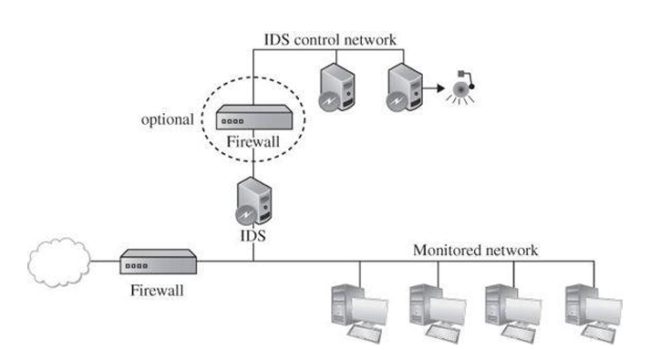
Stealth Mode
If the IDS needs to generate an alert, it uses only the alarm interface on a completely separate control network. Such an architecture is shown in Figure.
Stealth mode IDS prevents the attacker from knowing an alarm has been raised.
IDS Control Network

Slide 82
Accurate Situation Assessment
Intrusion detection systems are not perfect, and mistakes are their biggest problem.
Although an IDS might detect an intruder correctly most of the time, it may stumble in two different ways: by raising an alarm for something that is not really an attack (called a false positive, or type I error in the statistical community) or not raising an alarm for a real attack (a false negative, or type II error).
Too many false positives, as with the Target breach, means the administrator will be less confident of the IDS’s warnings, perhaps leading to a real alarm’s being ignored.
But false negatives mean that real attacks are passing the IDS without action. We say that the degree of false positives and false negatives represents the sensitivity of the system.
Most IDS implementations allow the administrator to tune the system’s sensitivity in order to strike an acceptable balance between false positives and negatives.

Slide 83
IDS Strengths and Limitations
Intrusion detection systems are evolving products.
On the upside, IDSs detect an ever-growing number of serious problems. And as we learn more about problems, we can add their signatures to the IDS model. Thus, over time, IDSs continue to improve. At the same time, they are becoming cheaper and easier to administer.
On the downside, avoiding an IDS is a high priority for successful attackers. An IDS that is not well defended is useless. Fortunately, stealth mode IDSs are difficult even to find on an internal network, let alone to compromise.
IDSs look for known weaknesses, whether through patterns of known attacks or models of normal behavior. Similar IDSs may have identical vulnerabilities, and their selection criteria may miss similar attacks. Knowing how to evade a particular model of IDS is an important piece of intelligence passed within the attacker community. Of course, once manufacturers become aware of a shortcoming in their products, they try to fix it. Fortunately, commercial IDSs are pretty good at identifying attacks.

Slide 84
IDS Strengths and Limitations
Another IDS limitation is its sensitivity, which is difficult to measure and adjust. IDSs will never be perfect, so finding the proper balance is critical.
An IDS does not run itself; someone has to monitor its track record and respond to its alarms. An administrator is foolish to buy and install an IDS and then ignore it.
In general, IDSs are excellent additions to a network’s security.
Firewalls block traffic to particular ports or addresses; they also constrain certain protocols to limit their impact.
But by definition, firewalls have to allow some traffic to enter a protected area. Watching what that traffic actually does inside the protected area is an IDS’s job, which it does quite well.

